Slide 1


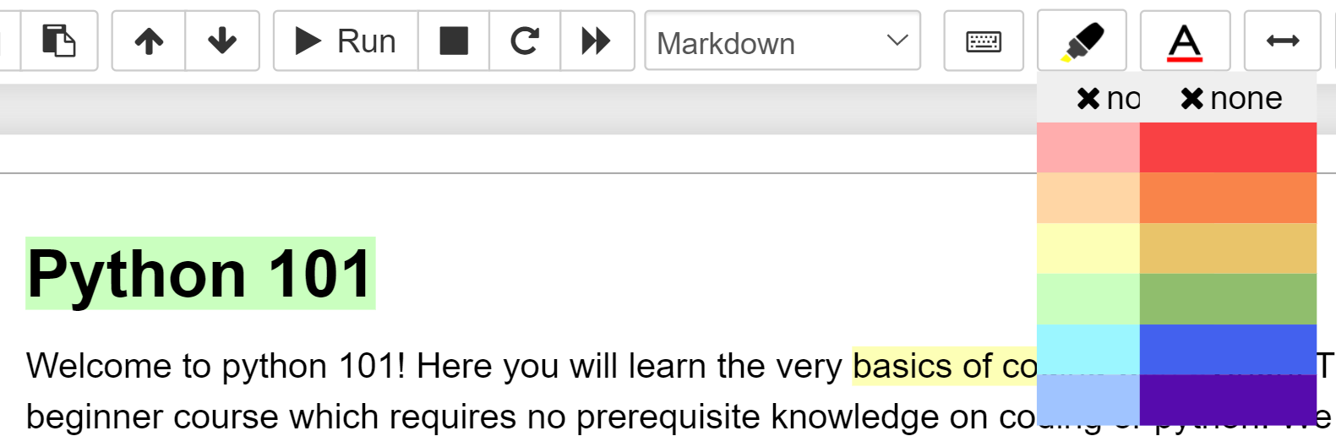
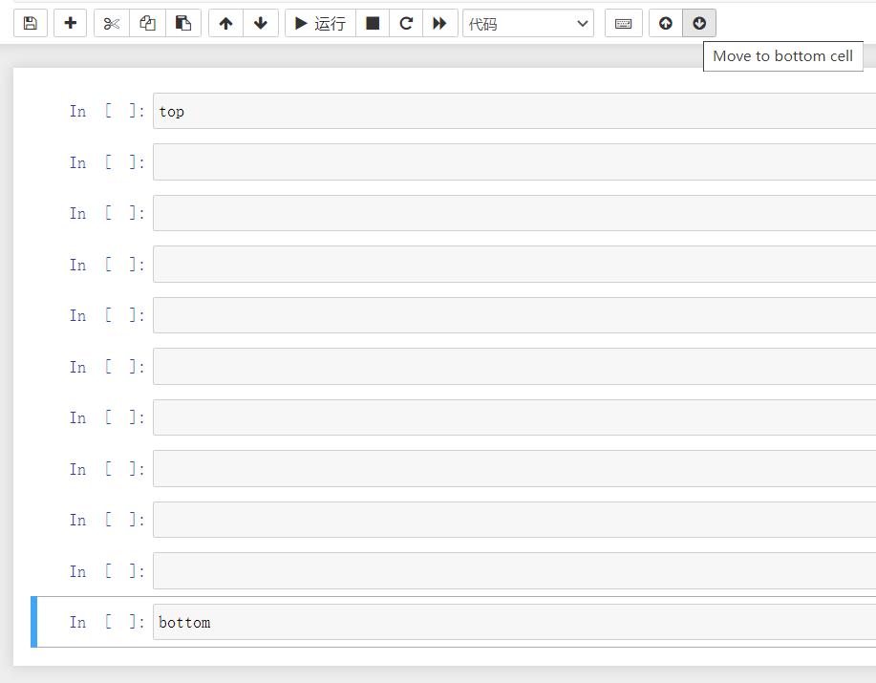
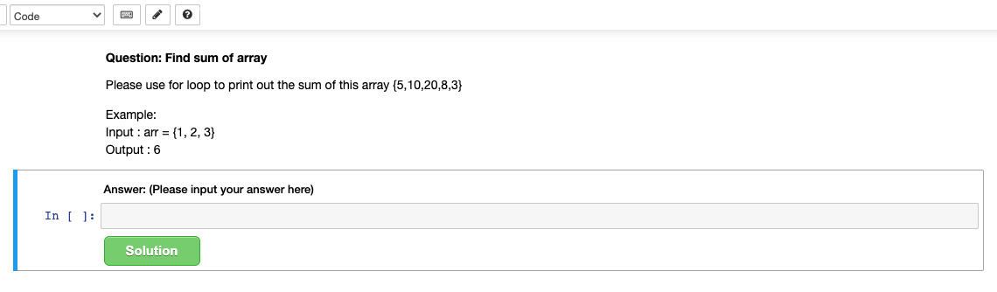
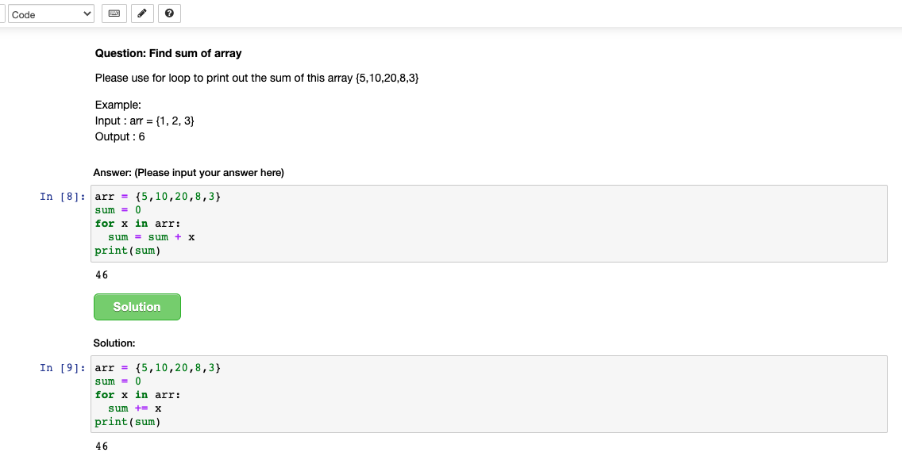
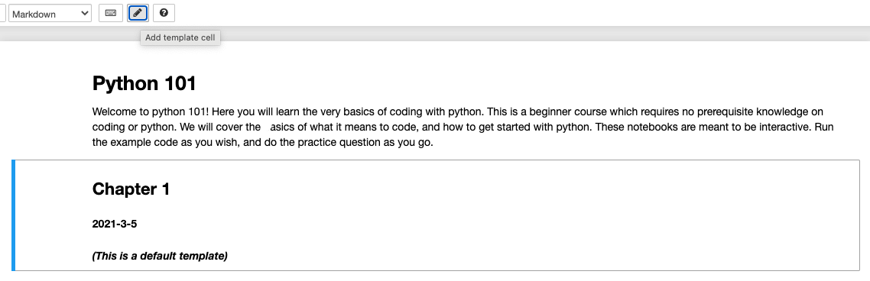
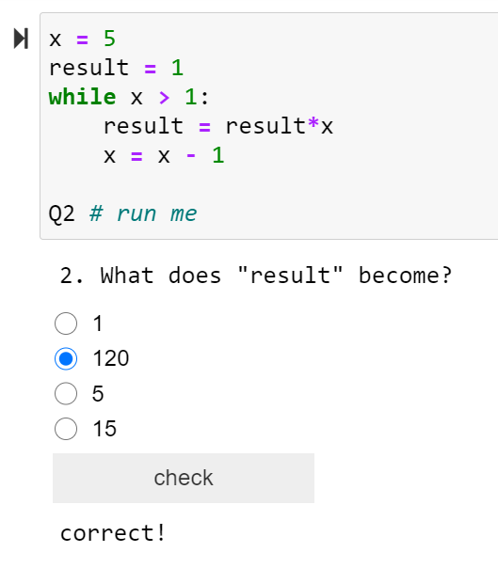
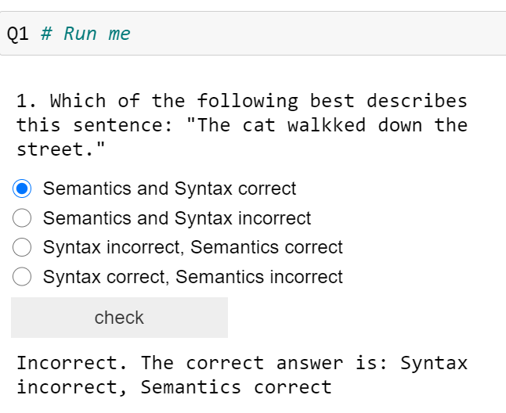
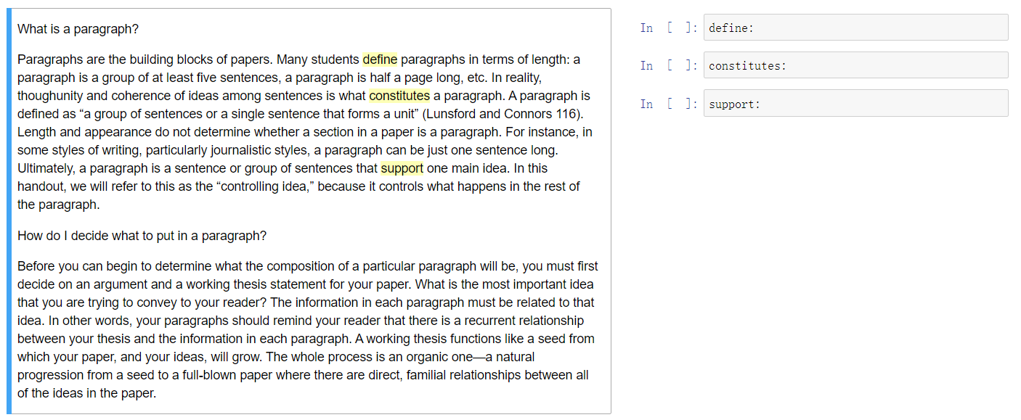
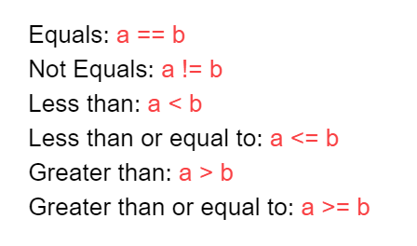
Jupyter Notebook Extensions For Teaching and Learning
Andrea Mitchell, Jenny Sun, Derek Huang
Supervised by Burton Ma
Introduction
Jupyter Notebook is an open-source web-based application
Users can code and visualize their data in an online learning environment
It has great potential for teaching and learning
The framework of Jupyter Notebook still requires some improvements
Method
Limited documentation on Jupyter Notebook extensions
Researched Jupyter’s Architecture for a deeper understanding
Frontend: HTML5 / CSS
Backend: Javascript
Used Jupyter’s open source code, and previous extensions to learn how to add our own functionality
Purpose
The purpose of our project is to improve some missing functionalities of Jupyter Notebook that will make teaching and learning more effective.
Highlighting
Move Cell to top / bottom
Short Answer
Questions
Multiple Choice Questions
Template Cell
Text
Colour
Annotate Text
Conclusion
We developed six extensions for our project. Each extension has different functionality designed to meet the needs of different users. With the help of our extensions, students can have better experience with note-taking and interactive learning in Jupyter Notebook and instructors will have additional options when creating the content in Jupyter Notebook.

